Slide 1
Chr21_44024948_C_G_b38
Model 4 Example
Chr21_44092475_G_C_b38
Chr21_44057219_G_A_b38
Chr21_44067413_T_G_b38
Chr21_44057275_A_G_b38
Chr21_44070803_G_A_b38
Chr21_44029964_A_G_b38
Chr21_44089769_G_A_b38
GATD3B
PWP2
Chr21_44072497_A_G_b38
Chr21_44055608_G_C_b38
GATD3A
ENSG00000275464

Slide 3
Adipose Visceral
Brain Cerebellum
Brain Nucleus Accumbens
Brain Substantianigra
Cells Cultured Fibroblasts
Testis
Chr19:38812203
Chr19:39763843
Chr19:39785683
Chr19:38970293
Chr19:38908269
ENSG00000200754
MT-TM
ENSG00000201938
LGALS4
LINC01661
ENSG00000235140
Trans Gene
MIR3118-2
Model 4 Example
Cis Gene

Slide 4
M3 Example
Heart Left Ventricle
chrX:154506456
LINC02020
MTND4P24
Brain Cerebellar Hemisphere; Brain Frontal Cortex; Adipose Visceral; Artery Coronary; Adrenal Gland; Brain Cerebellum; Cells Cultured fibroblasts; Colon Sigmoid; Colon Transverse; Esophagus Mucosa; Esophagus Muscularis; Lung, Nerve Tibial; Pancreas; Skin Not Sun Exposed; Thyroid; Whole Blood; Heart Atrial Appendage
MCFD2
MIR3178
chrX:154516183
MTC03P22
MTND1P23
Minor Salivary Gland
chrX:154529974
Ovary; Testis
chrX_154531643
Adipose Subcutaneous; Skin Sun Exposed; Uterus
chrX_154591448
FAM3A
Brain Spinal cord
chrX_154600913
Trans Gene
Cis Gene

Slide 5
Example M2 Trio
chr7:106258959:Artery Tibial
chr7:106249852:Cells Cultured Fibroblasts
chr7:106285885:Esophagus Muscularis
chr7:106276191:Heart Atrial Appendage
chr7:106279429:Heart Left Ventricle
chr7:106263458:Whole Blood
NAMPT
NAMPTP1
Trans Gene
Cis Gene

Slide 6
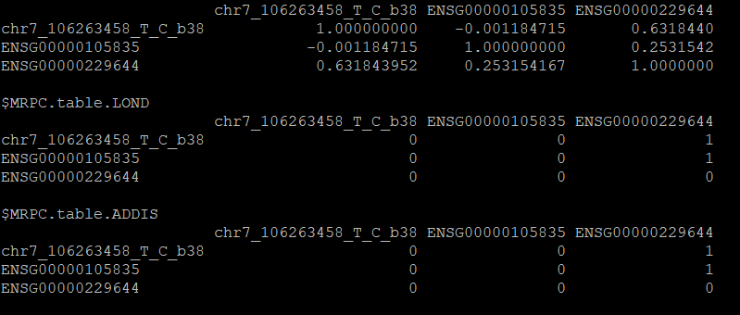
M2 adjacency matrix :Whole Blood

Slide 7
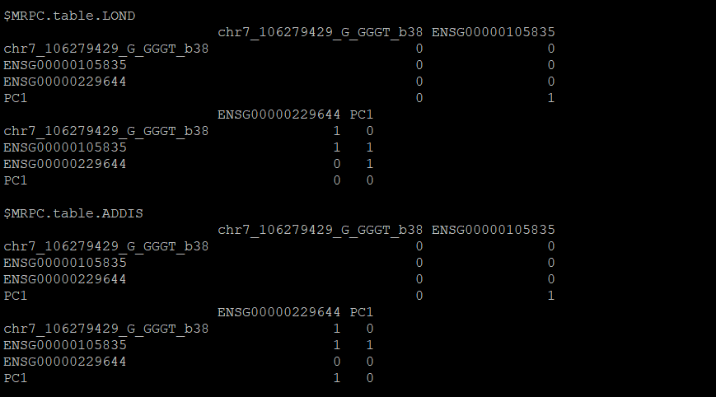
M2 adjacency matrix : Heart Left Ventricle

